Slide 1
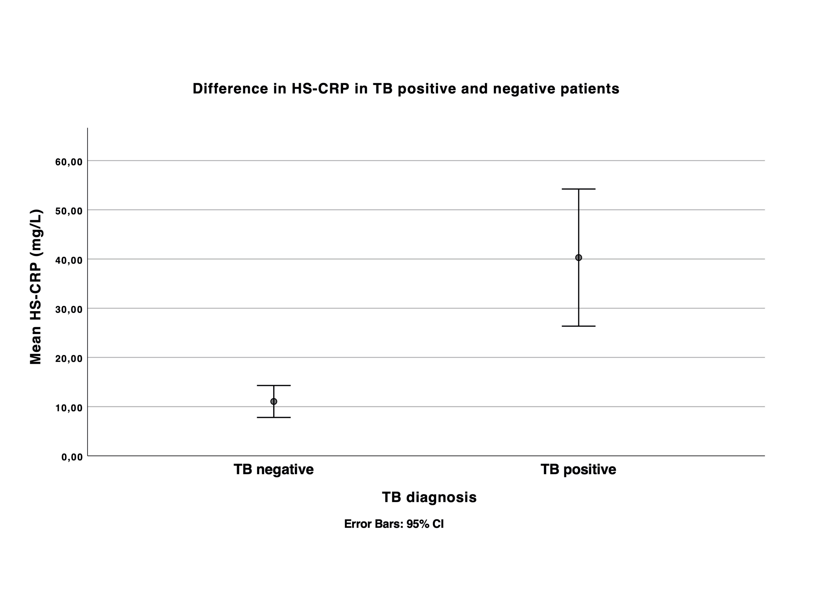
Enhancing TB diagnosis in HIV+ patients in Kenya:
preliminary results of IDEA-TB study in a cohort from DREAM program
F. Ciccacci¹, K. Wouters², B. Welu³, H. Ndoi³, I. Karea³, S. Orlando⁴, D. Brambilla⁵, K. Munene³, P. Giglio⁵, B. Opanga⁶, A. Ronoh⁷, S. Mukwanjagi⁸, R. Mwiraria⁸, G. Guidotti⁹, M.C. Marazzi¹⁰
¹UniCamillus, International University of Health and Medical Science, Rome, Italy, ²Institute of Tropical Medicine, Department of Clinical Sciences, Antwerp, Belgium, ³Community of Sant'Egidio, DREAM program, Meru, Kenya, ⁴University of Rome Tor Vergata, Department of Biomedicine and Prevention, Rome, Italy, ⁵Community of Sant'Egidio, DREAM program, Rome, Italy, ⁶National AIDS and STIs Control Programme, Nairobi, Kenya, ⁷National Tuberculosis, Leprosy and Lung Disease Program, Nairobi, Kenya, ⁸Consolata Hospital, Nkubu, Kenya, ⁹ASL RM 1, Rome, Italy, ¹⁰LUMSA, Rome, Italy
Background: TB has still a high prevalence and mortality worldwide, also representing the leading cause of death in HIV+ people. In Kenya, in 2018, 32.000 people died due to TB, and 40.000 HIV+ patients were diagnosed with TB in the same year. In 2016 only 63,4% of people with TB worldwide were diagnosed; the diagnosis of TB among HIV+ patients is particularly challenging. The objective of the present study is to improve TB diagnosis among HIV+ patients. High sensitivity C-reactive protein (HS-CPR), LF-LAM test, and Gene Xpert will be evaluated in order to define diagnostic algorithms for TB in HIV+ patients.
Methods: IDEA (Innovative Diagnostic Enhancement Against) TB is a prospective study aimed to evaluate innovative diagnostic tools for TB in HIV+ patients. HIV+ consecutive adult patients attending the sites of the study (DREAM Centers in Meru/Nchiru, Chaaria, Nkubu) who were clinically suspected of having TB and referred for Gene Xpert were enrolled. Each participant was entered in the datasheet (demographic, anthropometric and clinical data) and tests were performed: urinary LF-LAM-test, serum HS-CRP and Gene Xpert on sputum.
Results: In nine months (May-December 2019), 389 TB-suspected patients were enrolled. 62.5%(243/389) were female, the median age was 46(±12) years, 26.7%(104/389) patients were malnourished, and the median CD4 count was 417 [IQR 237-643]. TB was diagnosed on a total of 63(16.19%) patients (either LAM or Xpert positive test). Concordance between Xpert and LAM test was 85.3%. HS-CRP was significantly higher in TB patients (40.2 mg/L vs 11.0 mg/L, p<0,000) (Figure 1). The only predictor of TB diagnosis was plasmatic HS-CRP level higher than 10 mg/L (OR 4.01 [2.28-7.06]). No association between TB, CD4 count or BMI was observed.
Conclusions: Diagnosing TB infection in HIV+ patient remains challenging, as concordance among different tests is suboptimal. HS-CRP could serve as an additional tool in TB diagnosis in HIV+ patients.
PRESENTED AT THE 23RD INTERNATIONAL AIDS CONFERENCE (AIDS 2020) | 6-10 JULY 2020
| PEB0129
Corresponding author: fausto.ciccacci@gmail.com

